Slide 1
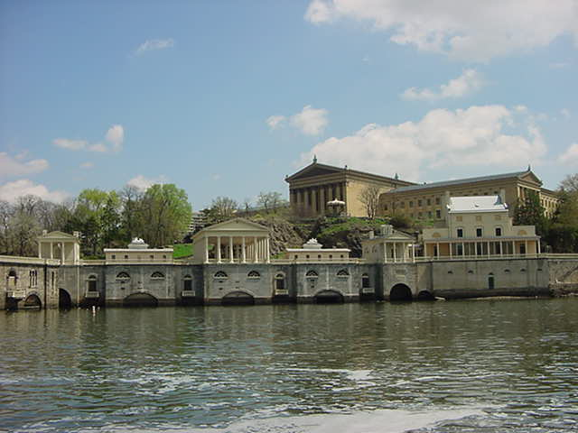
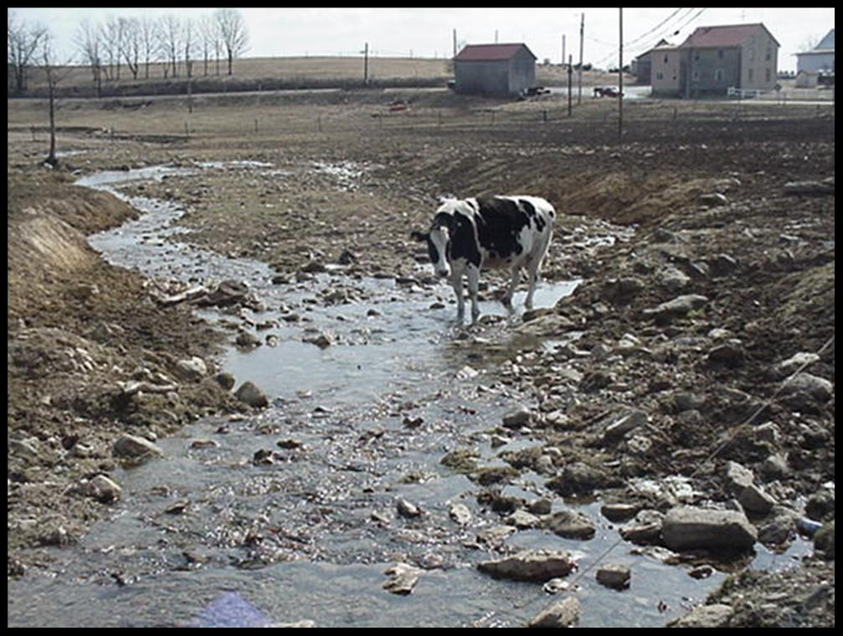
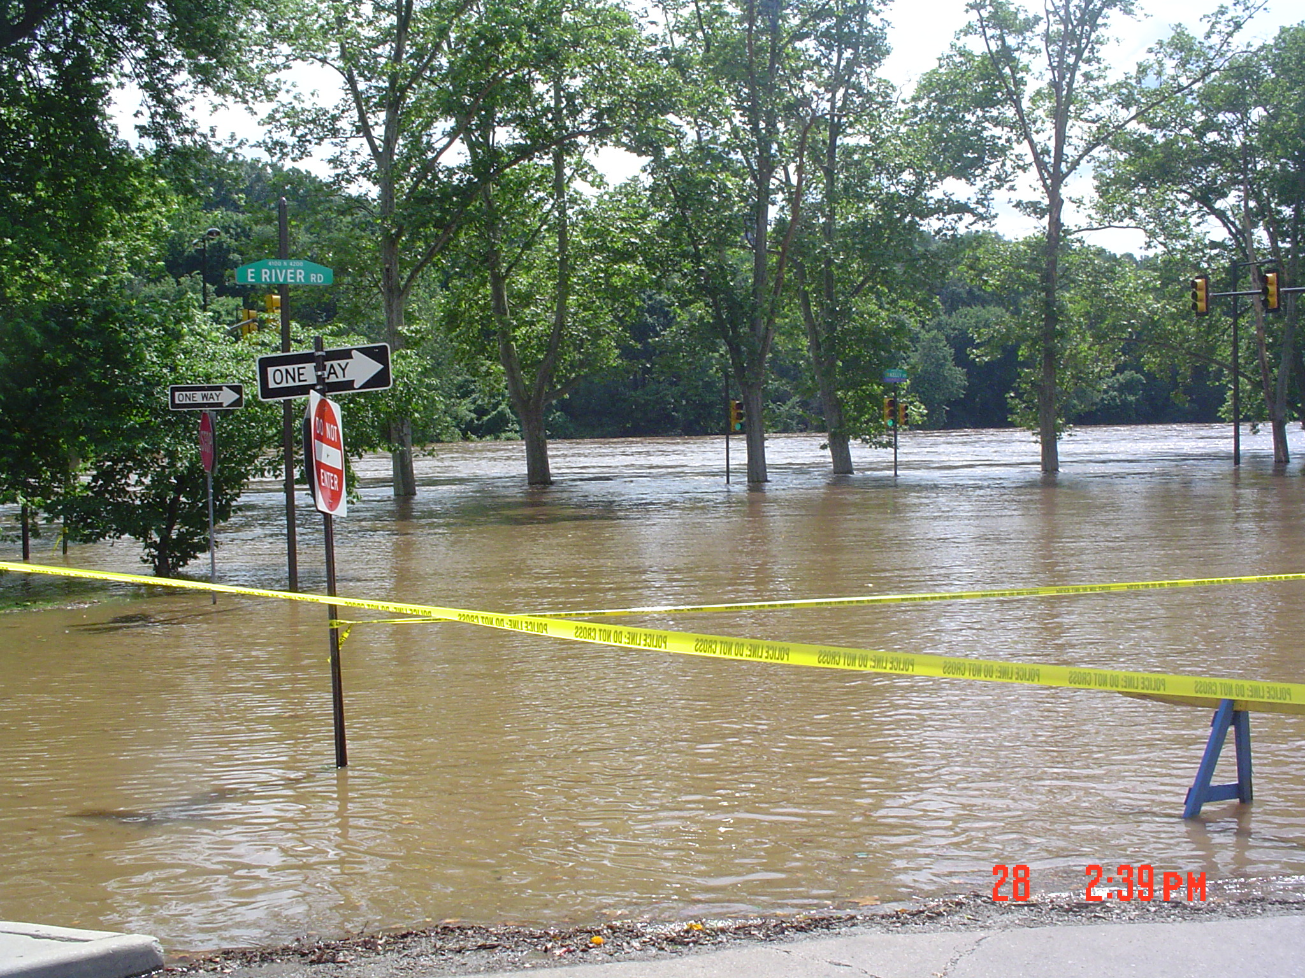
Regional Coordination for Implementation of Source Water Protection Projects
October 24th, 2013
Kelly Anderson
Philadelphia Water Department’s Source Water Protection Program

Slide 2
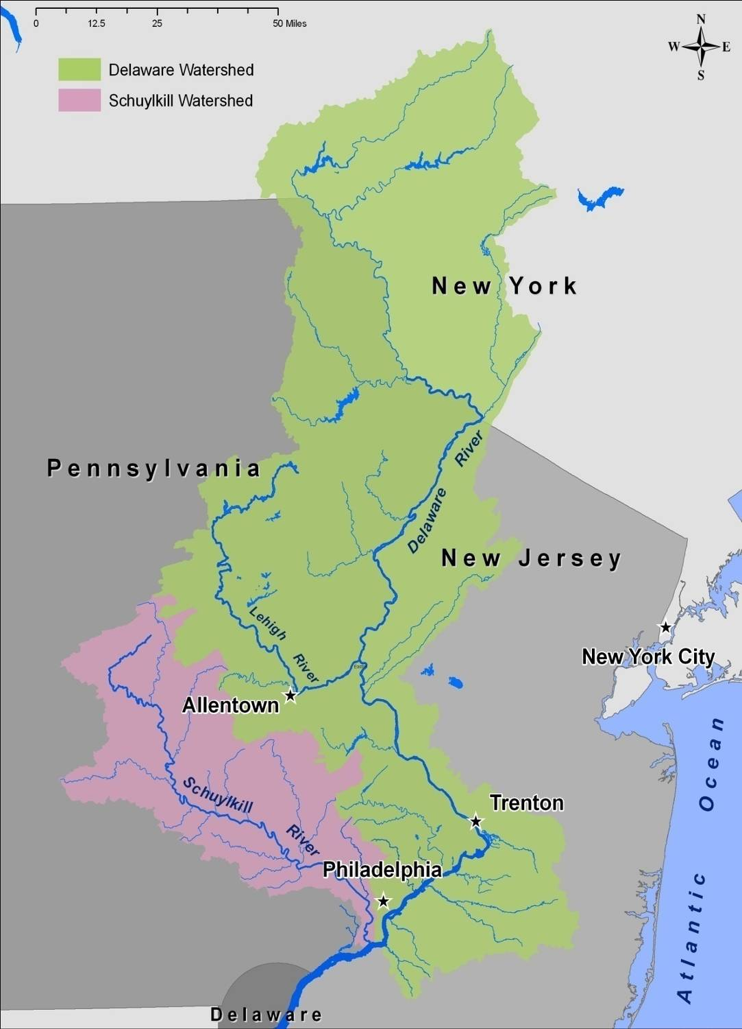
Philadelphia Drinking Water
Two sources
  Delaware River
  Schuylkill River
Three water treatment plants
560 million gallon per day capacity
Serves 1.45 million people
Two Drinking Water Plants on the Schuylkill River
Schuylkill River Watershed
  2,000 sq. miles
  11 counties
  More than 200 towns
  Thousands of upstream point sources

Slide 3
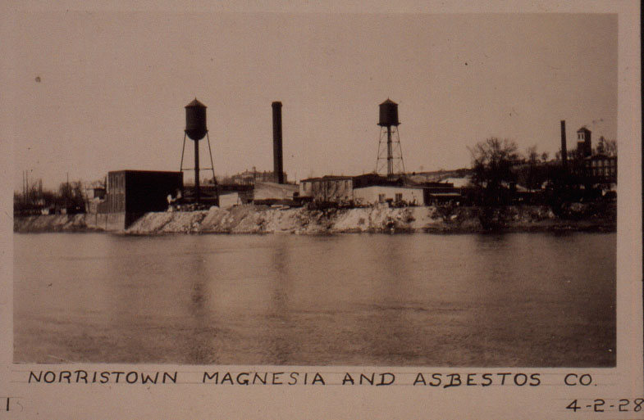
By the mid 1880s, fouled water, factory waste, coal by-products, and agriculture and urban runoff were being drained into our rivers at an alarming rate.
“How offensive is the stench, when the air is heavy and the wind blowing from the Southwest.”
-John Frederick Lewis
Notes:
3
The Philadelphia region was an industrial hub throughout the 1800s

Slide 4
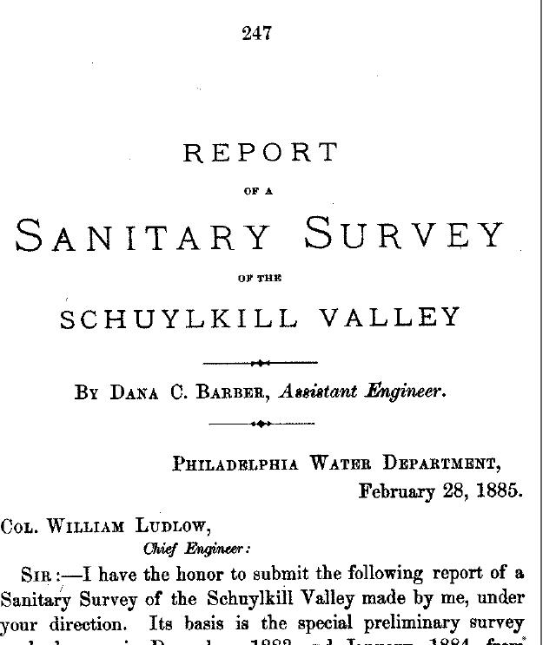
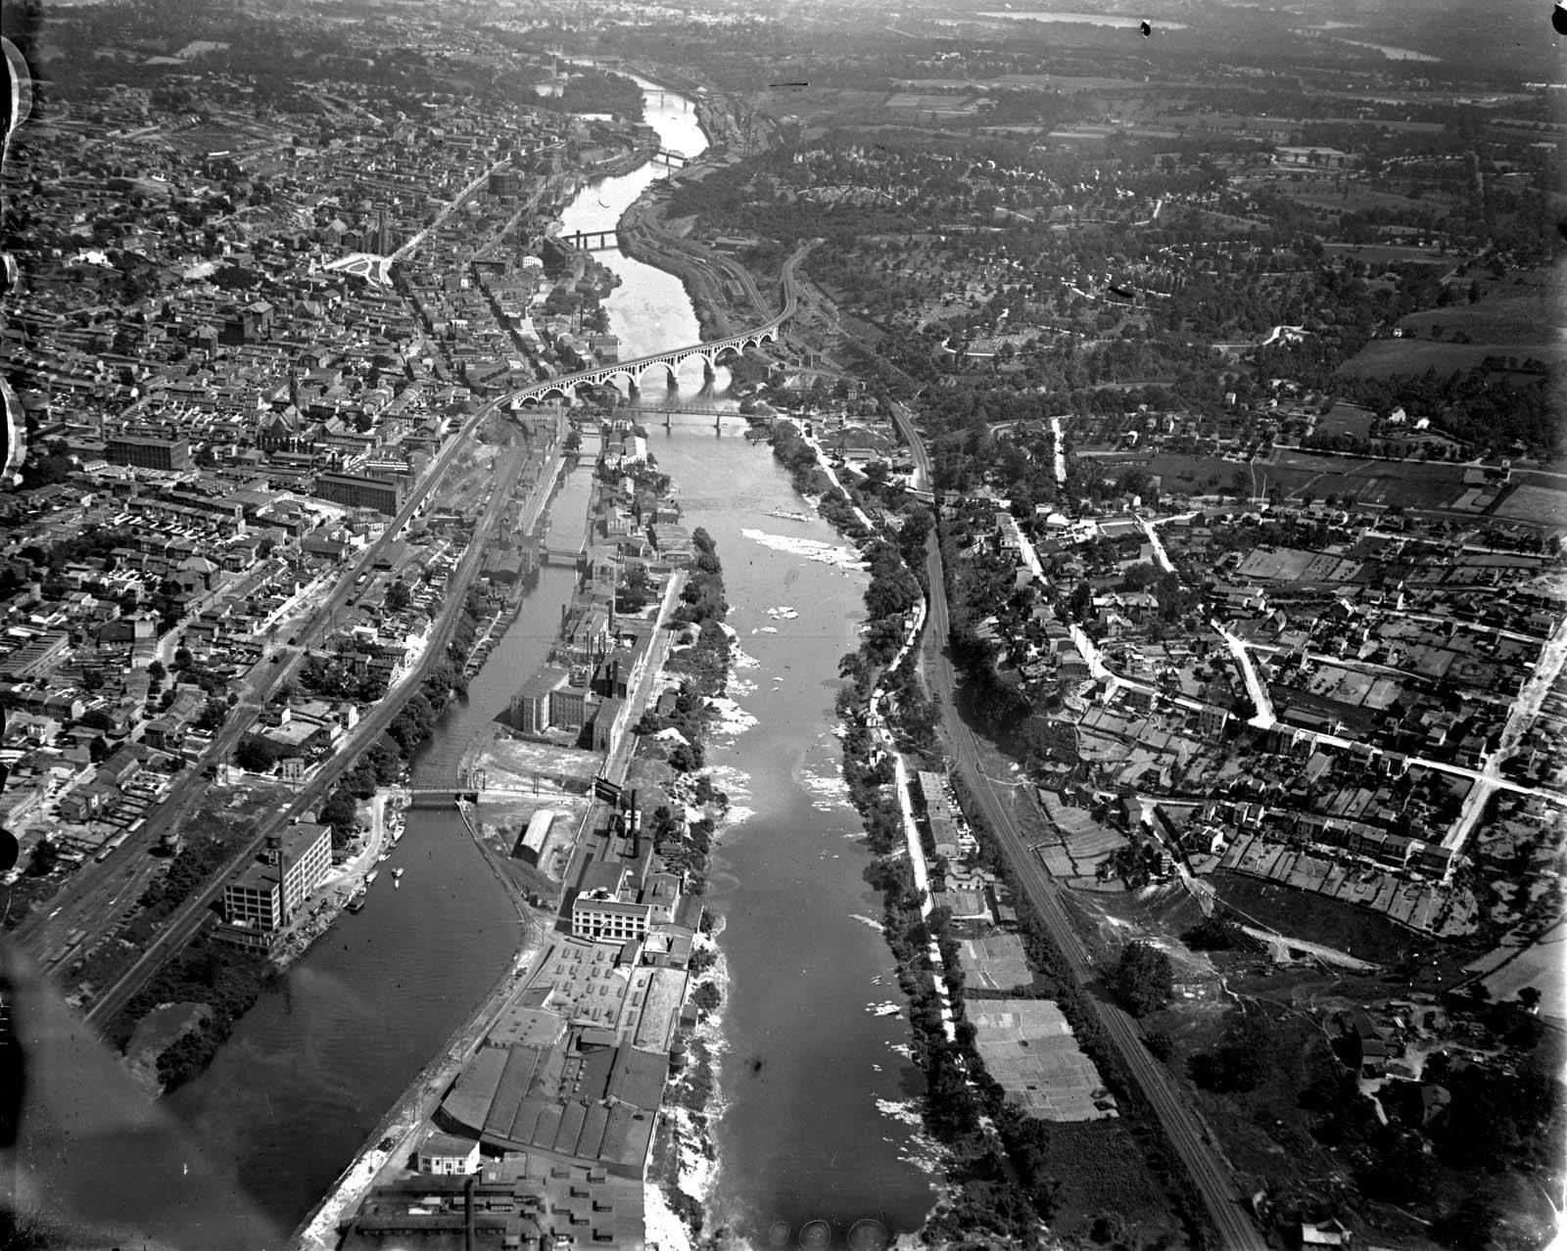

Slide 5
Philadelphia’s Water Supply in Context
Philadelphia
New York City
Source Water Protection
Source Water Protection
Water
Treatment
Water
Treatment
Water comes from working rivers
Intakes are at bottom of watersheds
We control less than 1% of area of influence
No filtration
Undeveloped watersheds
Source Water program is only means of protection

Slide 6
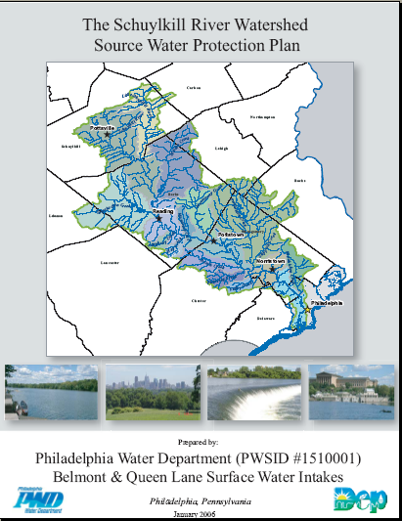
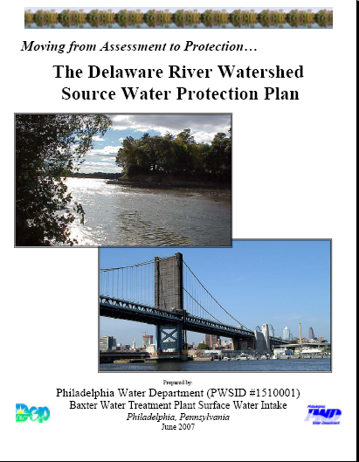
Philadelphia’s Source Water Protection Program
Goal
  Protect and improve the quality and quantity of our rivers to support drinking water, ecology, and recreation.
Approach
  Develop Philadelphia as a model for source water protection for upstream communities
  Create mechanisms for regional coordination across geographic, regulatory, and jurisdictional boundaries
  Use science to identify and advance policies that sustainably protect Philadelphia’s water supply
Notes:
6

Slide 7
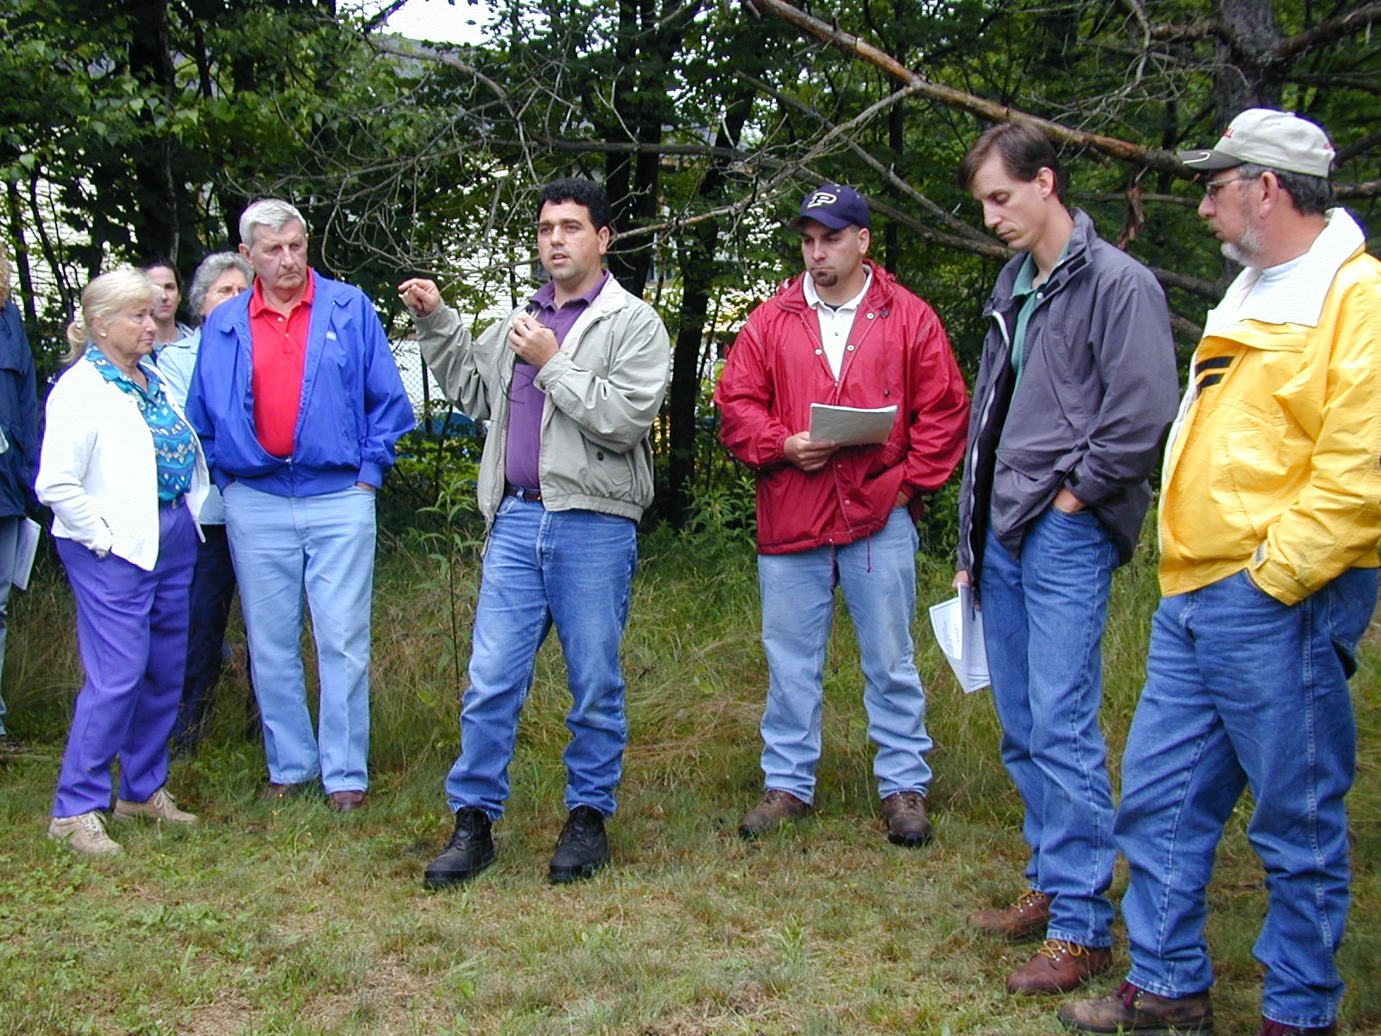
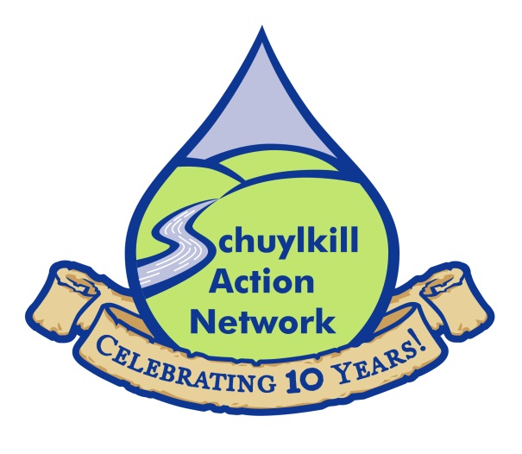
Regional Coordination: Schuylkill Action Network (SAN)
Spearheaded by EPA Region III, PWD, PDE, and PA DEP
Formed to address priorities of Philadelphia’s Source Water Assessments
Includes local watershed organizations, water suppliers, corporations, universities, and local, state and federal government
Over 415 individual members
160+ organizations
Recipient of 2004 EPA Targeted Watershed Initiative Grant ~ $1.4 million dollars for priority watershed projects
Over $20 million leveraged for priority projects since 2003
www.schuylkillwaters.org

Slide 8
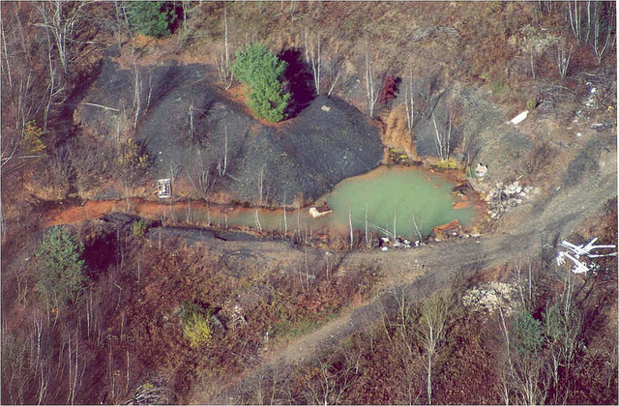
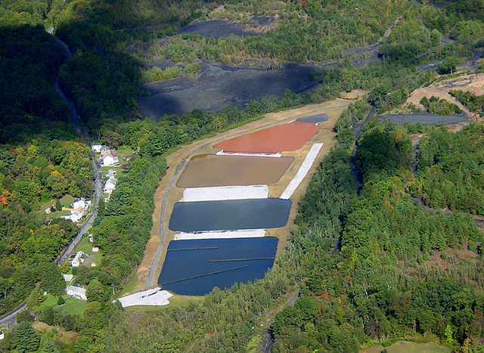
SAN Workgroups
Acid Mine Drainage
$14 million invested into nearly 45 projects
  Coal silt stabilization
  Infiltration abatement
  Mine land reclamation
  Planning
  AMD Treatment systems
  Watershed studies
BEFORE
AFTER
Agriculture
175 farm improvement projects
  Streambank fencing
  Riparian buffer plantings
  Animal crossings
  Manure storage basins
Silver Creek AMD treatment system

Slide 9
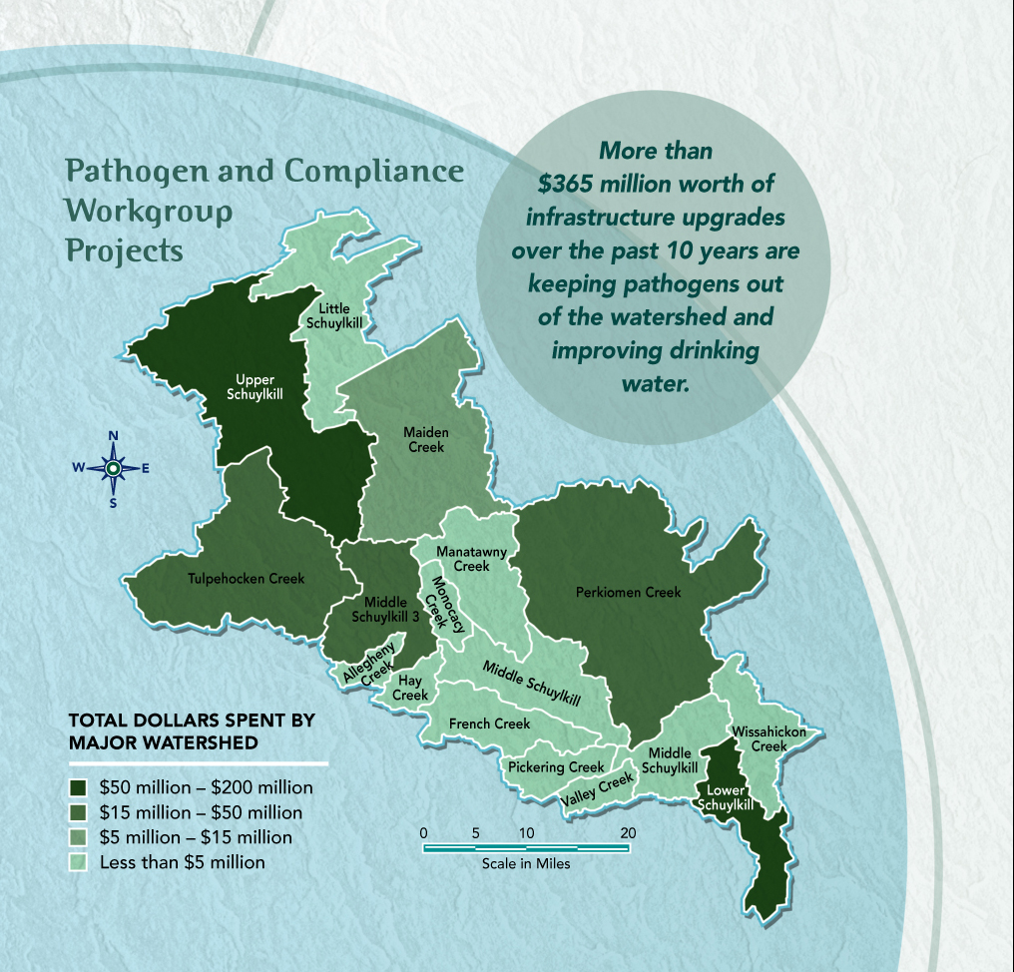
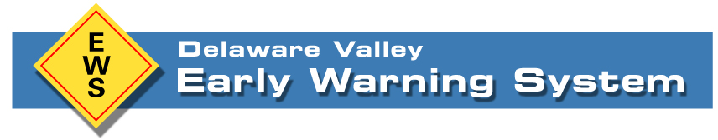
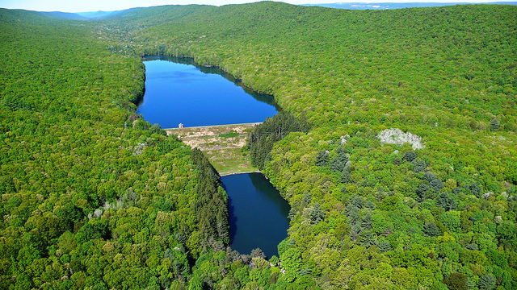
Pathogens and Compliance
$365 million in infrastructure upgrades
  Significant PennVest investments
  Technical assistance to sewage treatment plant operators
  Sewage discharges reduction
  Sewer system capacity improvements
  On-site septic system operation and maintenance improvements
Development and expansion of the Delaware Valley EWS
Land Prioritization Collaborative
Land prioritization tool
  Ranks land based on drinking water protection
Land Transaction Assistance Program
  Helped complete 6 easements totaling over 500 acres

Slide 10
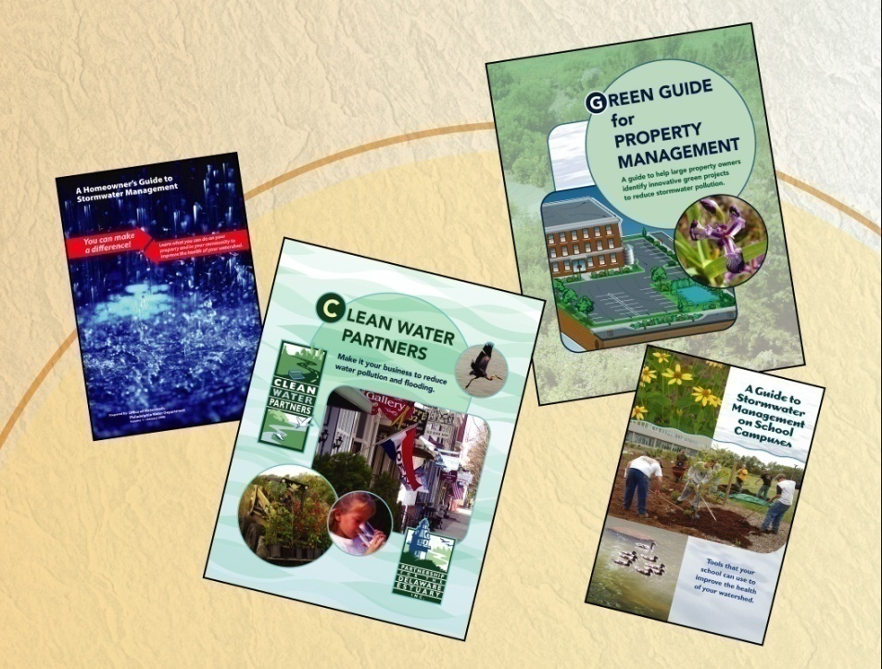
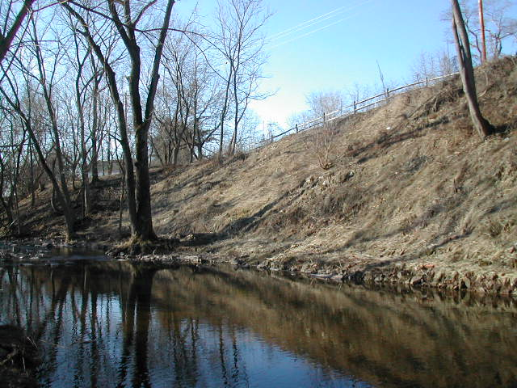
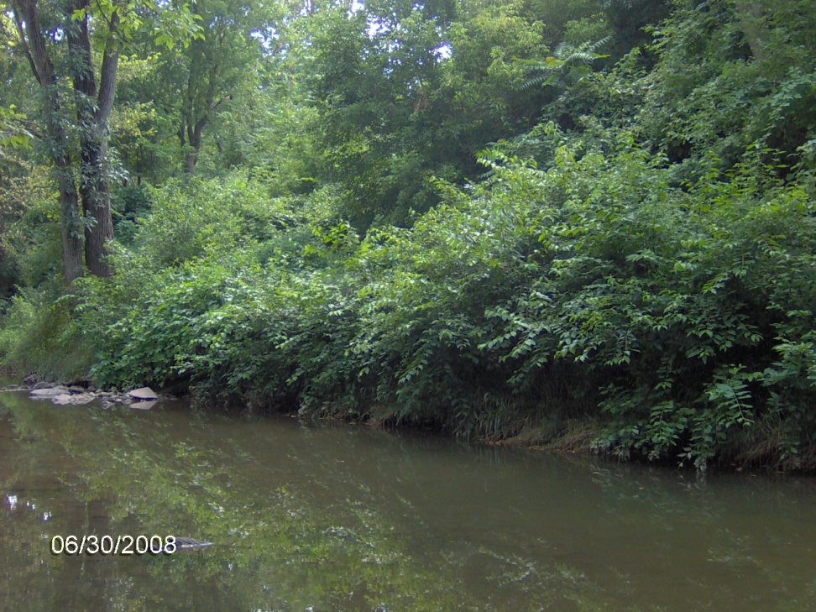
Stormwater
$ 21 million invested in over 200 projects
  Swales
  Naturalized basins
  Green roofs
  Tree plantings along stream
  Rain gardens
  Streambank stabilization
Schuylkill Action Students
  Stormwater solutions on school campuses
Education and Outreach
Stormwater guides
  Homeowners
  School campuses
  Property management
Schuylkill Scrub
  Over 90 watershed wide clean up events
Drinking Water Scholastic Awards
Pilot pharmaceutical take back program
Schuylkill Shots photo competition
Spokesdog competition
BEFORE
AFTER
Norristown Farm Park streambank restoration

Slide 11
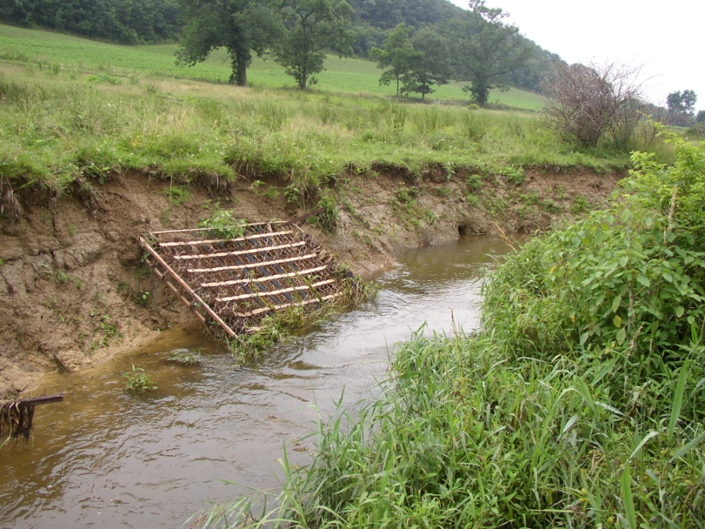
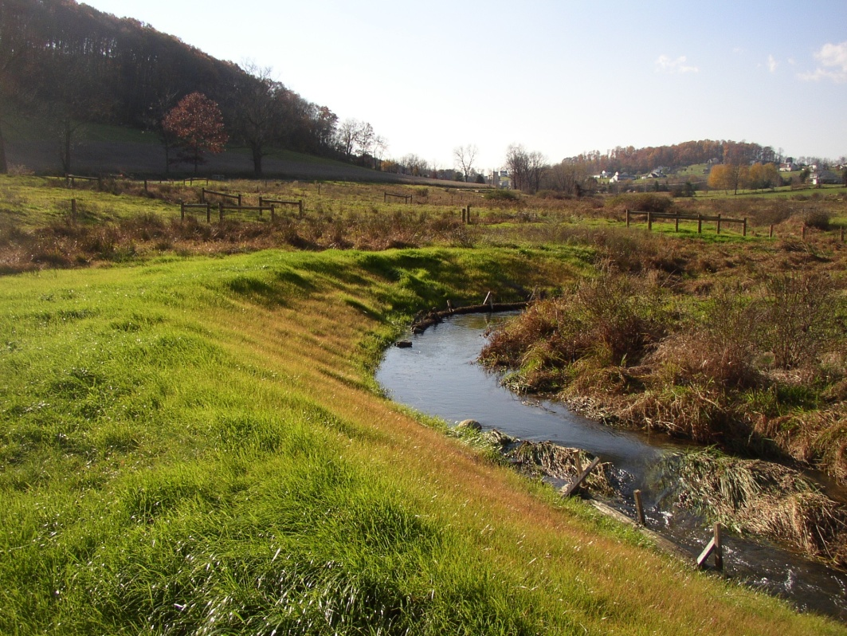
Schuylkill River Restoration Fund (SRRF)
The SRRF provides grants to government agencies and non-profit organizations for projects that improve the quality of water in the watershed
Over 30 projects since 2006
  Acid mine drainage
  Agricultural remediation
  Stormwater runoff improvements
  High priority land protection
$ 2.2 million contributed from:
  Exelon Nuclear Corporation
  Philadelphia Water Department
  Aqua Pennsylvania
  Partnership for the Delaware Estuary
Eroded streambank
BEFORE
AFTER
Healthy streambank

Slide 12
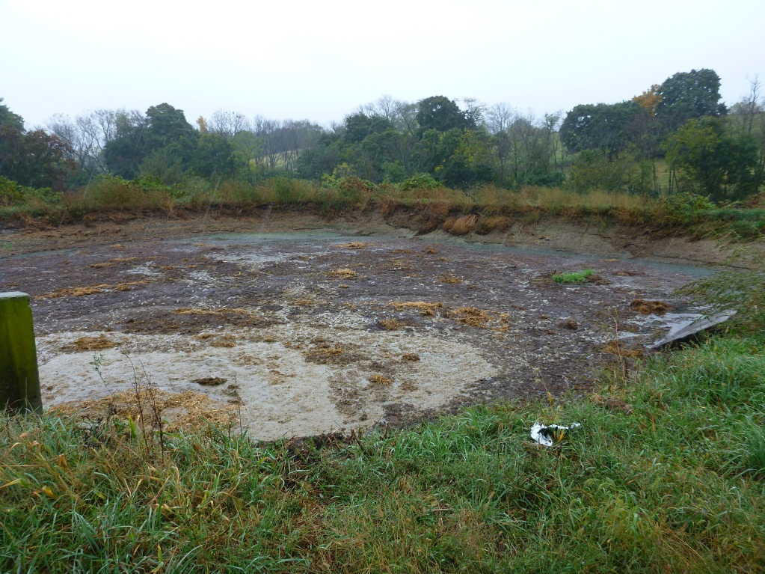
LT2 Watershed Control Plan
One Philadelphia water treatment plant on the Schuylkill River fell into Bin 2 of the Long Term Control 2 Surface Water Treatment Rule and required mitigation for levels Cryptosporidium detected.
For back up compliance credits, PWD developed and implemented a Watershed Control Plan (WCP) to reduce Cryptosporidium in the watershed.
PWD contributes funds to Schuylkill River Restoration Fund and provides input on project selection for grants.
Agricultural BMPs implemented on farms through the SRRF support the WCP Program.
This earthen lagoon with a scoured liner was formally used to store manure, but will be replaced with a concrete storage basin at this SRRF farm.

Slide 13
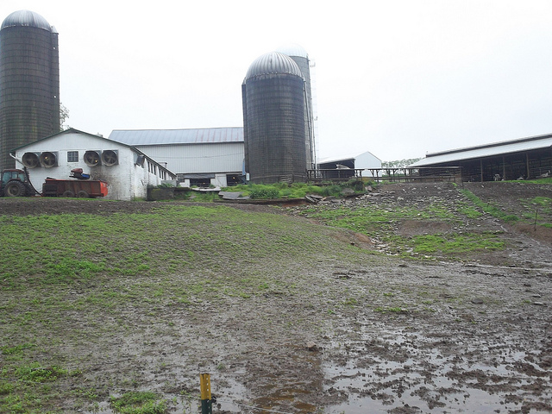
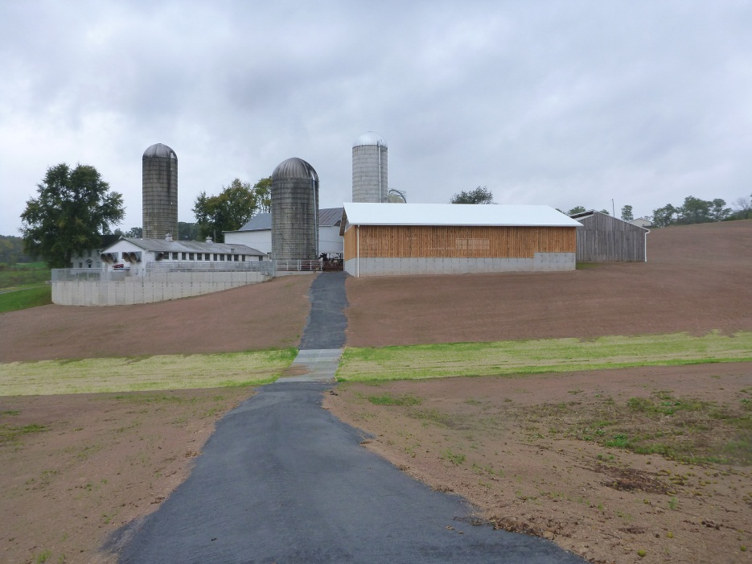
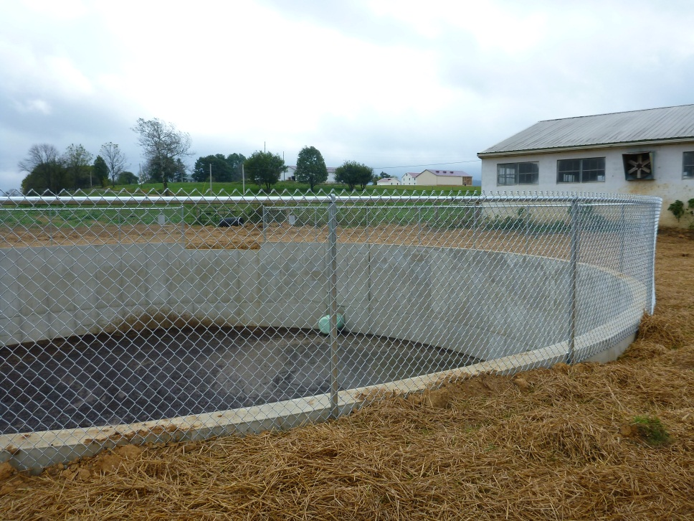
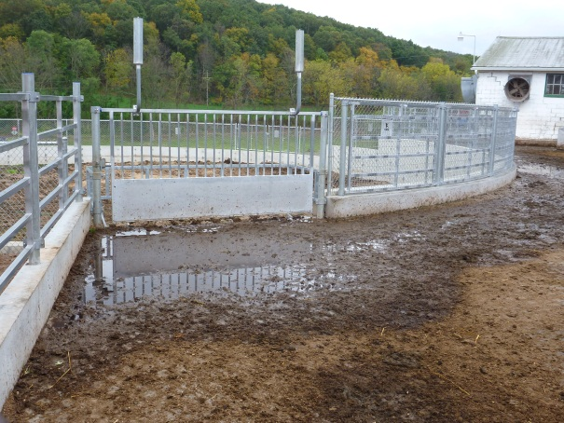
SRRF Farm BMP Projects
BEFORE
AFTER
A nearly completed concrete liquid manure storage unit will prevent the waste from contaminating rainwater runoff at this SRRF farm.
An animal walkway, animal crossing, manure storage unit and stormwater controls will prevent contaminated runoff from reaching the nearby stream in Schuylkill Watershed at this SRRF farm.

Slide 14
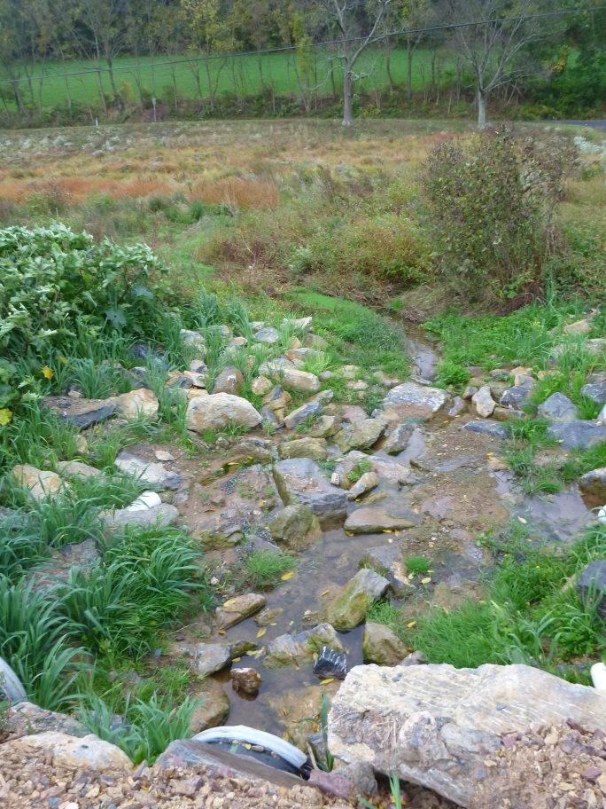
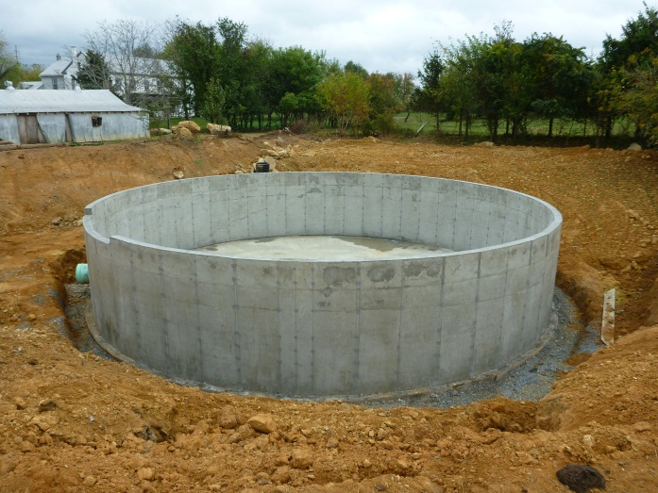
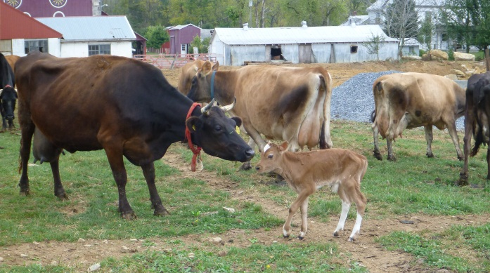
Summary
Philadelphia has very little control over its source water and is committed to addressing concerns facing our water supply through regional partnerships.
By leveraging public and private resources, priority watershed protection projects can be accomplished to better protect a region’s drinking water supply
Notes:
14

